Slide 1
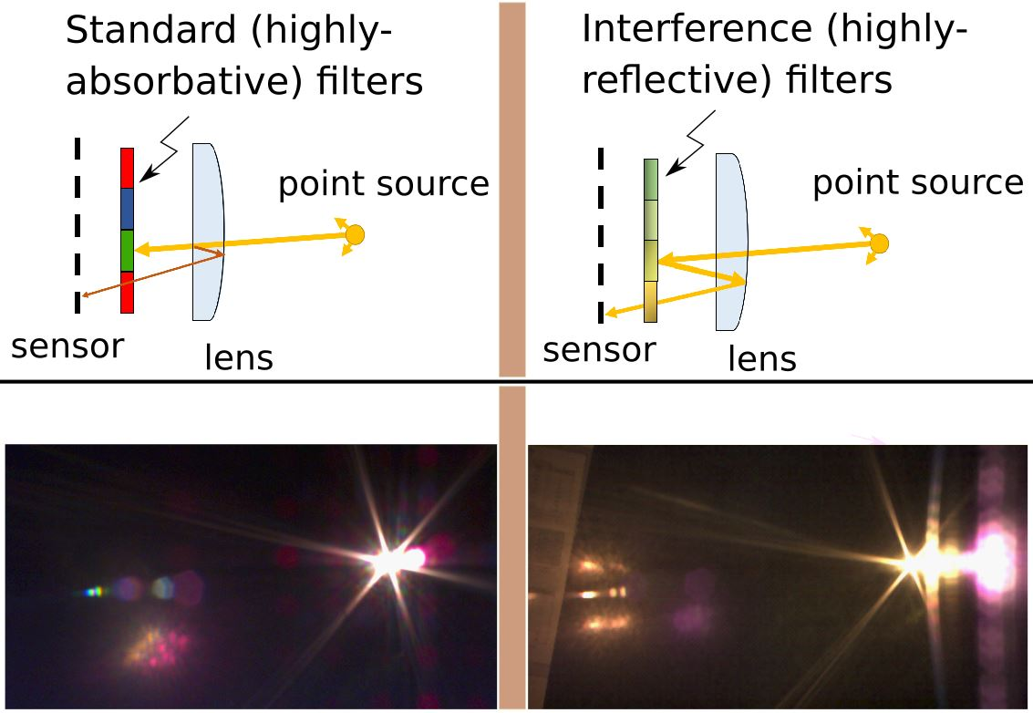


Flare in Instant Hyperspectral Cameras
Eden Sassoon
Supervised by:
Yoav Y. Schechner , Tali Treibitz
Vision & Image sciences Lab
The Hatter Department of Marine Technologies
Notes:
The title of our work is 'Flare in Instant Hyperspectral Cameras' and this project was supervised by Tali and Yoav.
Just a quick note about the figure. The purpose of this study was to point to a caveat in interference based hyperspectral sensors. Because these sensor are effective mirrors, considerable radiance is directed backward toward the objective lens (typical of reflective sensor surfaces –this is shown in the figure – here we hold a comparison between standard sensors and SHYC). This in turn causes biases in the hyperspectal measurmenets. We want to tell you that it contaminates in the order of several percent even for high performance AR coated lenses and list some photometric properties. This is a contribution to known camera effects, e.g. lens flare which a well known and widely studied camera phenomnon.

Slide 2
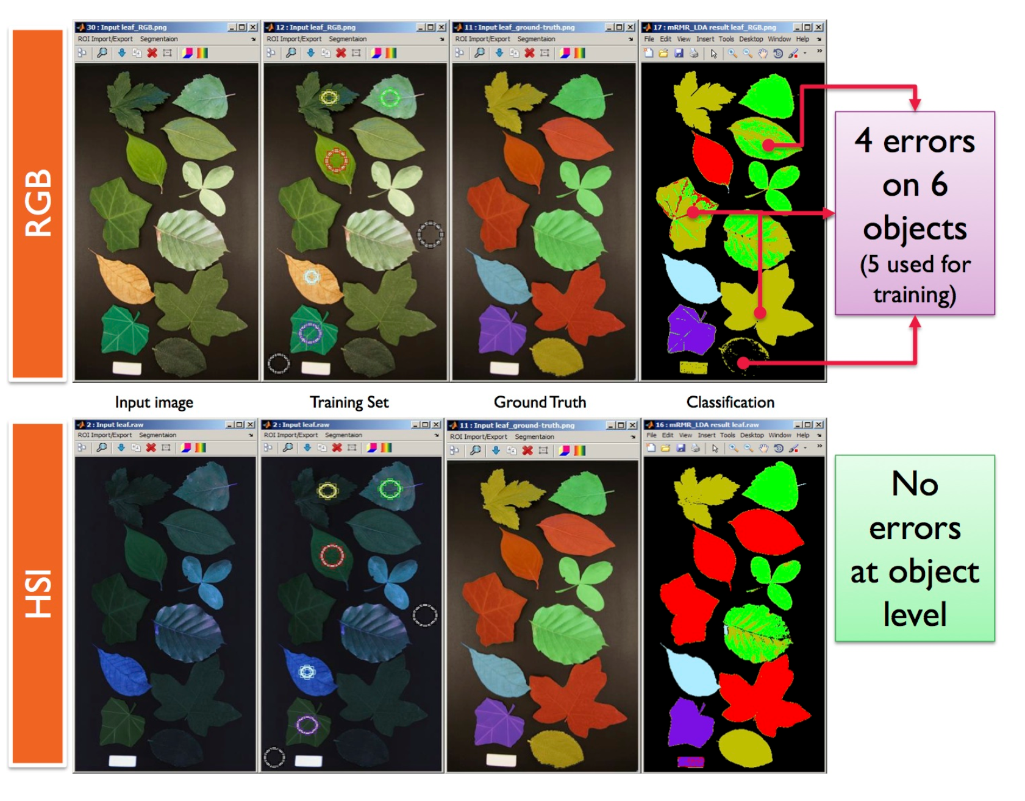
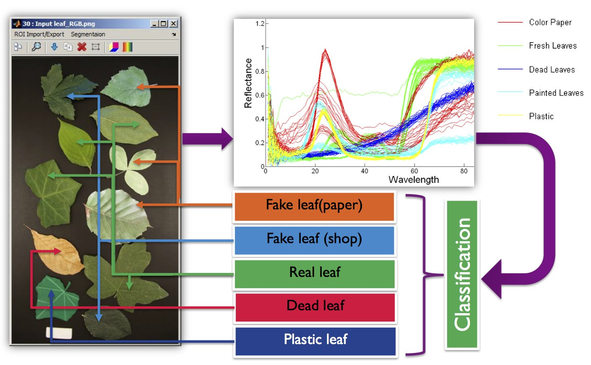
Why Hyperspectral?
Notes:
First, why are we interested in hyperspectral cameras?
If we consider what we record in regular RGB cameras- we record 3 wide band colors in high resolution.
Let us look at this example: green leaves were recorded with an RGB camera. Some are real and some are fake. Can we tell from the image which is which?
In pixel level – in traditional RGB images it is impossible.
However, when we look at the spectral signatures, there is a difference which yields correct classification at data level for SHYC.
-----
I’d like to convince you that Hyperspectral images are more informative than normal RGB cameras.
The term Metamerism means objects with different power distribution that appear as having matching colors. The picture here was taken from a brochure of a company which develops Hyperspectral sensors and we have such a camera and have used it in this work.

Slide 3
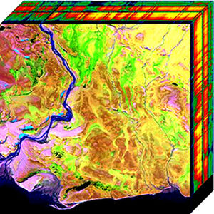
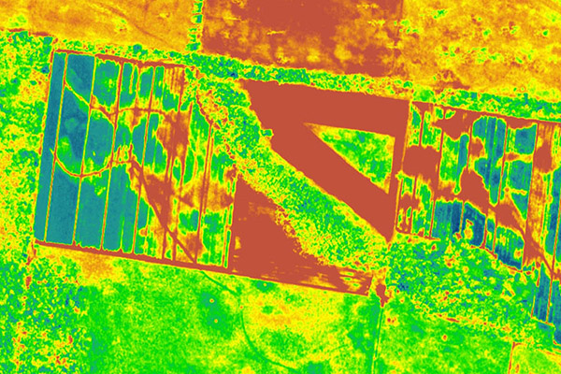
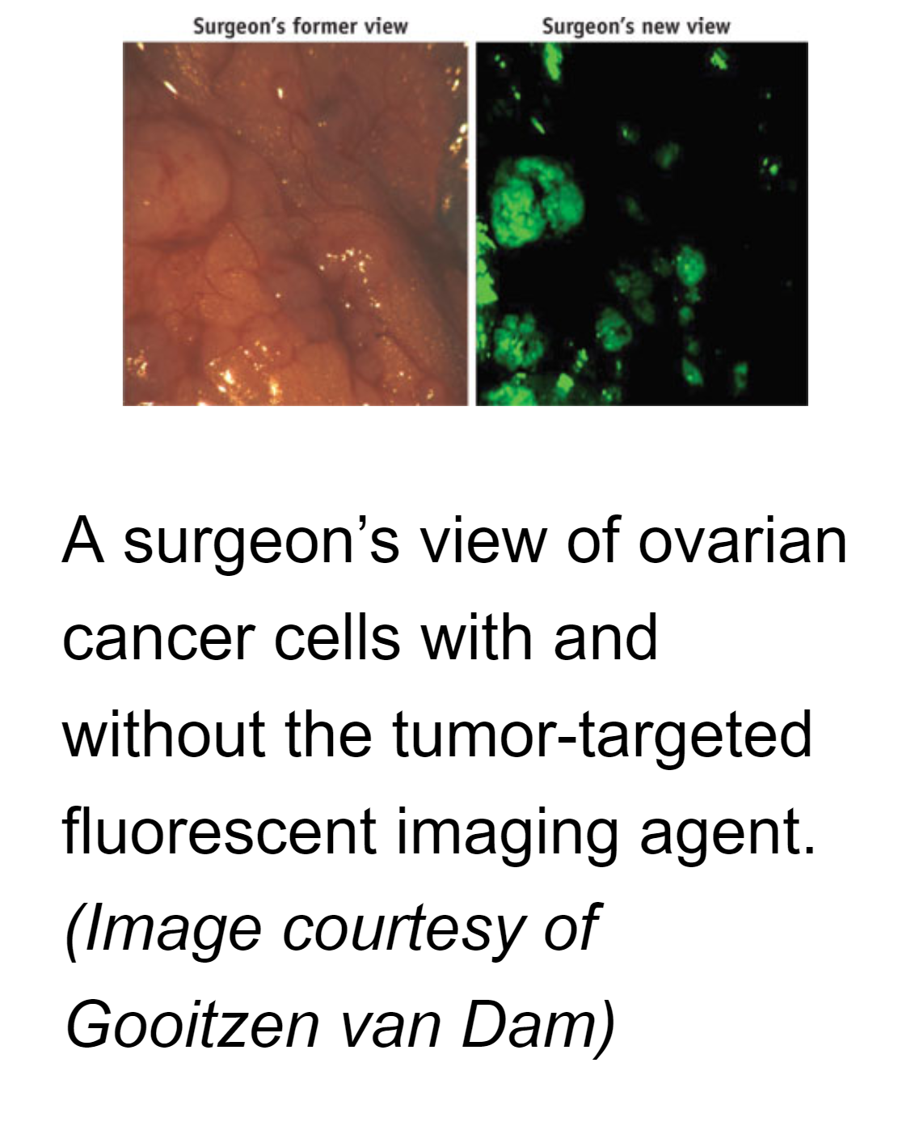
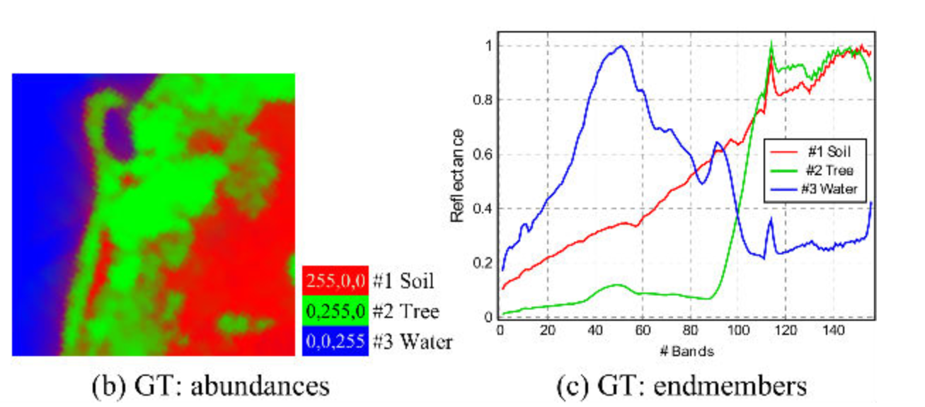
Hyperspectral images
Mapping HSI (Satellites, Aircraft)
  Minerals tracing, vegetation etc..
Medical
  Diagnosis, Surgery
Food safety and quality evaluation
  Imaging bacteria and other contaminators
RGB
Fluorescence
Notes:
Indeed, hyperspectral images are used in many domains: mapping, medical, agriculture etc…
------
Hyperspectral images are extremely informative. They are used in (1) satellite and aerial imaging for tracing materials, mapping vegetation (2)they are used in medicine for camera aided diagnosis and surgery. I refer you to the link here which summarizes over 20 different application for Hyperspectral in medical imaging. This image here (bottom) as probably part of human tissue which in both recorded by regular RGB and hyperspectral cameras. It is clear that hyperspectral cameras reveal more information and make it possible to produce the data required for richer and more accurate classification of objects in images.

Slide 4
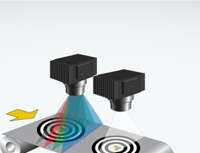
Hyperspectral cameras
Linescan
RGB
Wavelength resolution
Spatial resolution
Notes:
How can we record hyperspectral data?
There are different technologies by which Hyperspectral images can be recorded, however different technologies pose different resolution trade-offs. RGB cameras are on the low end of the wavelength resolution as they record only 3 wideband colors. Linescan cameras trade off one spatial axis for wavelength. Therefore they have high wavelength resolution but record intensities only over one spatial line – requiring temporal scanning to acquire a full image (which is very difficult in scenes with moving objects).

Slide 5
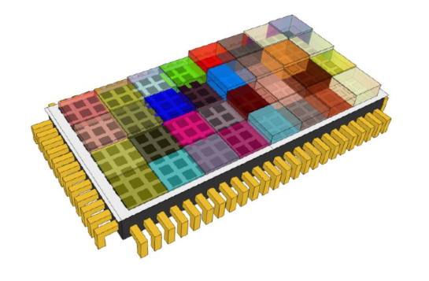
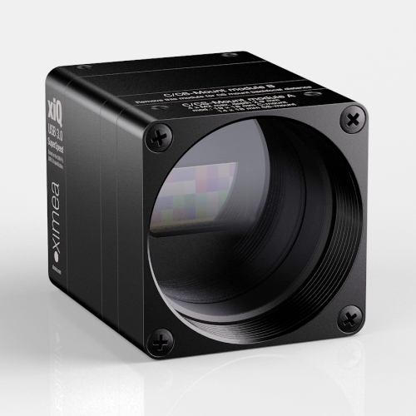
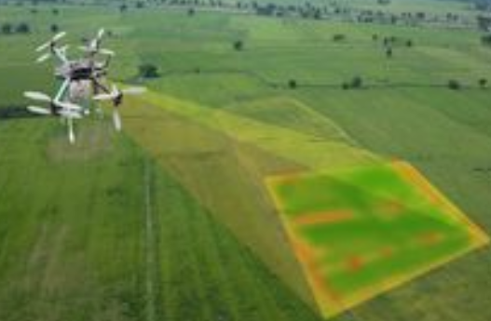
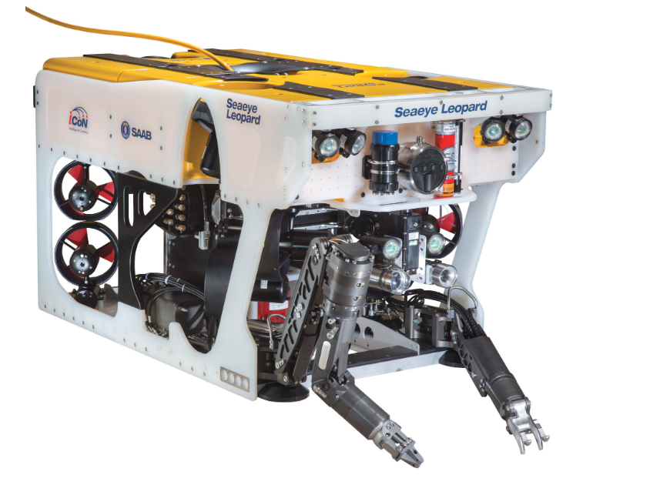
Instant Hyperspectral Cameras
Linescan
SHYC
RGB
Wavelength resolution
Spatial resolution
Enables imaging with moving platforms or of moving objects
Notes:
Recently, a new technology has been developed to balance these trade offs and enable instant hyperspectral imaging.
In this technology several narrow band filters are mounted directly in the sensor. Replacing the bayer pattern of the camera with a multi color matrix.
This technology trades-off spatial resolution for wavelength resolution, and it comes in a simple compact form like a normal RGB cameras, making it suitable for mounting on robotic devices. For example, look at this sensor from the IMEC company- that has 16 filters on it.
There are several companies making off-the-shelf instant hyperspectral sensors.

Slide 6
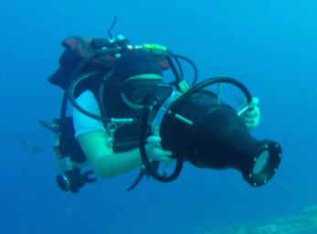



Used in our lab in a project studying the visual system of sea turtles
Derya Akkaynak and Deborah Levy
Notes:
Our lab became interested in this technology as we designed an underwater housing for such a camera to study the visual system of sea turtles. This project was funded by national geographic and took place in the Solomon Islands which are located south-east of Papua New Guinea.

Slide 7
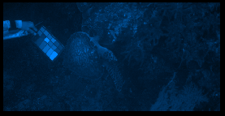
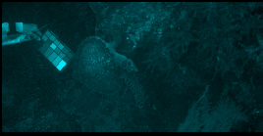
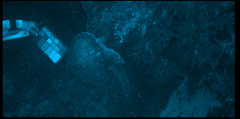
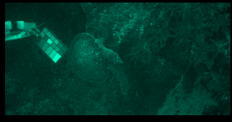
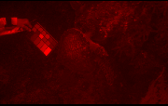
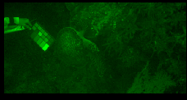
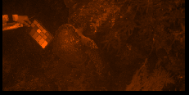
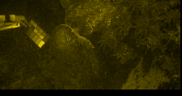
Coral
Tortoise
Algae
Notes:
For example, here are a few spectral reflectances it recorded.

Slide 8
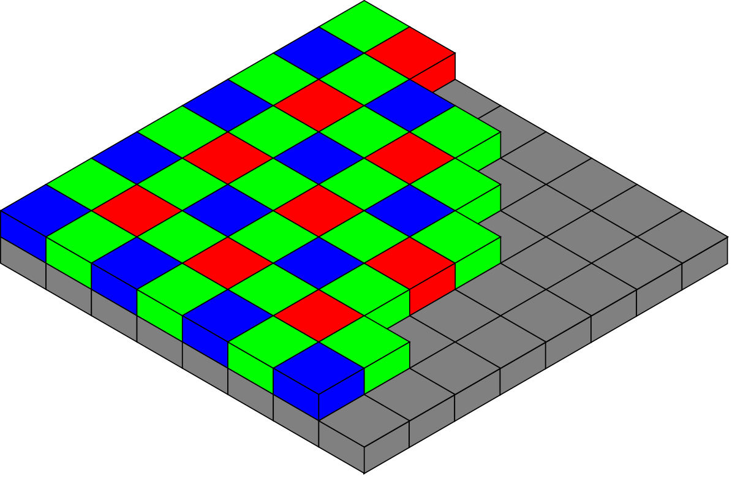
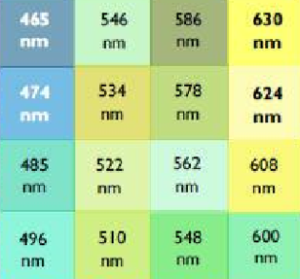
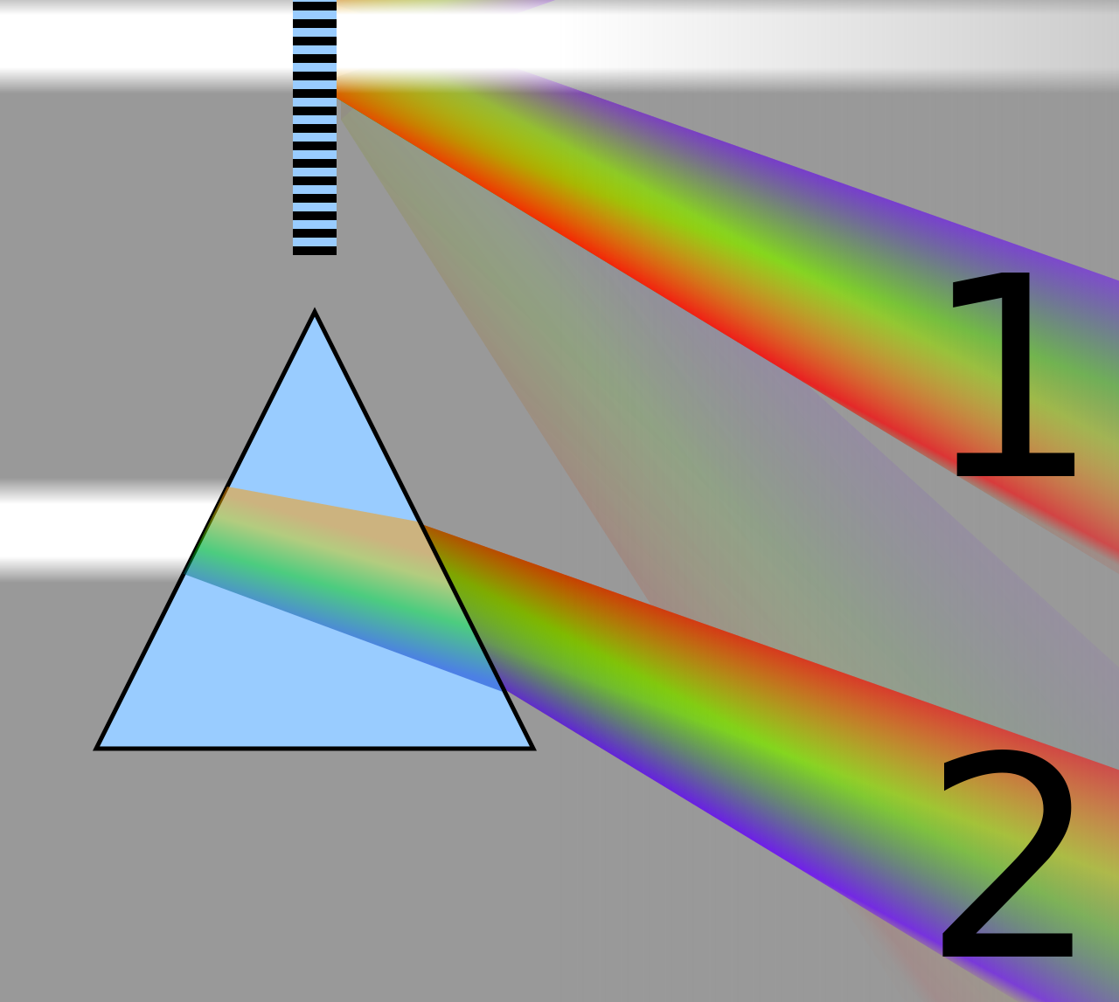
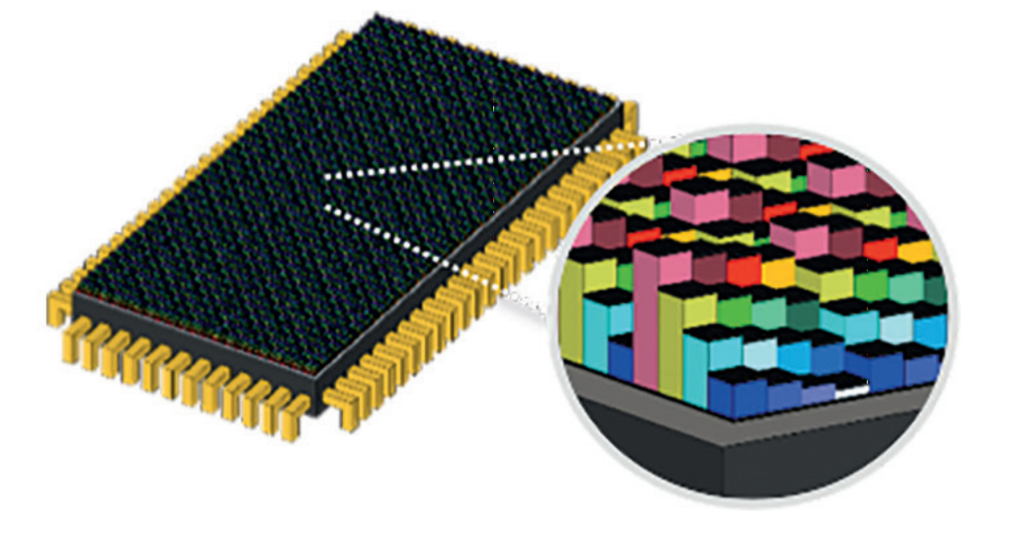
Hyperspectral cameras
Mosaic – Unit cell 4x4 pixels
spatial
wavelength
Notes:
So I said a lot in the previous slides about different Hyperspectral cameras and held a comparison, and I just want to show you the principle of these technologies. So, RGB cameras are simple mosaic of filters. In this way spatial resolution is reduced in each dimension by a factor of 2. Linescan cameras use a diffractive optical element (Prism) to separate light into different wavelength which are to be recorded on a 2D sensor. In this design a single spatial dimension is completely dedicated to wavelength resolution. In the Instant Hyperspectral, a larger mosaic 4x4 is used , with more filters to reveal more wavelengths, thereby trading-off more in spatial resolution (by factor 4).

Slide 9
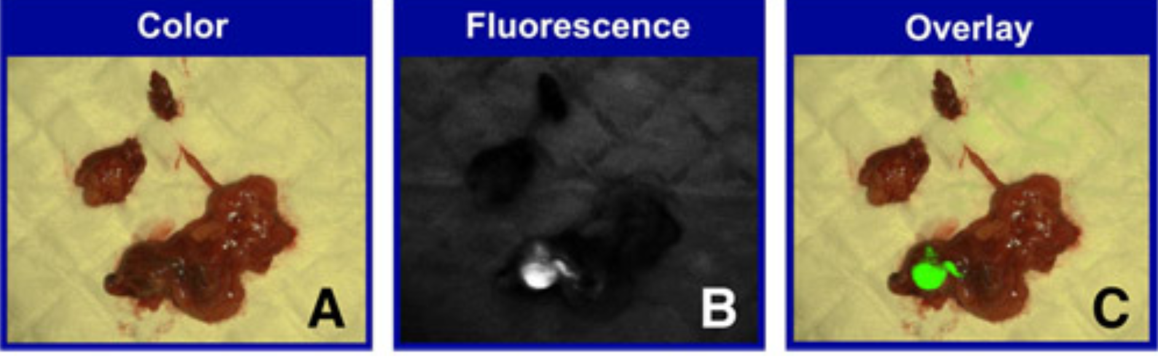
Applications with Instant Hyperspectral
Multispectral fluorescence imaging of a lymph node ex vivo
imaging of a lymph node ex vivo in cervical cancer
RGB
Fluorescence
Brouwer, Oscar R., et al. "Image navigation as a means to expand the boundaries of fluorescence-guided surgery." (2012)
Crane, Lucia MA, et al. "Multispectral real-time fluorescence imaging for intraoperative detection of the sentinel lymph node in gynecologic oncology." (2010).
Lu, Guolan, and Baowei Fei. "Medical hyperspectral imaging: a review."
Journal of biomedical (2014)
https://www.ncbi.nlm.nih.gov/pmc/articles/PMC3895860/
Notes:
The same camera was also used for several medical applications including real-time fluorescence imaging in video guided surgery.
The surgeons view with regular RGB and hyperspectral

Slide 10

Instant Hyperspectral Cameras
  Hyperspectral measurement of entire scenes in a single shot
  Compact and suitable for mounting on robotic devices
But we show that signal has strong contamination from flare
Notes:
So we saw that the Instant Hyperspectral technology gives the ability to sense a rich wavelength description of entire scenes by single shots – which is amazing but "it comes at a price”.
As we show in this work the design of the camera introduces significant flare to the image, which contaminates the images.
Now I will explain what is flare
-----------------
The filters used in this design are interference narrowband-pass filters called Fabry-Perot resonance cavities that reflect unwanted light. This caused considerable Flare and thus biases in the Hyperspectral data. Flare is a known issue in many electro-optic systems and is mainly caused by internal reflection by the optical elements.

Slide 11
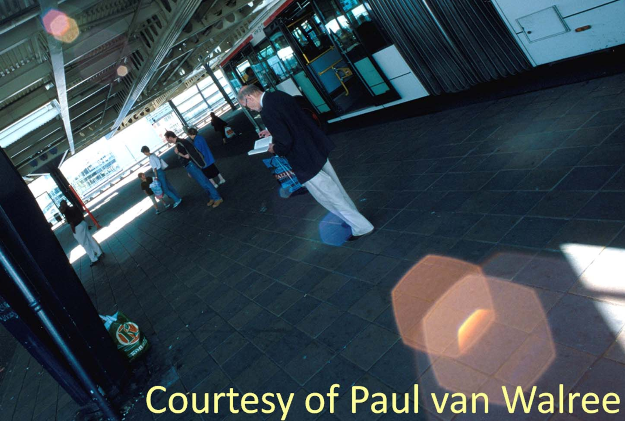

What is Flare?
Reflection coefficient 0.3% - 4%
Secondary reflection
Sun is about ${10}^{5}$ times brighter than the rest of the scene
Notes:
Flare also exists in regular cameras. It stems from internal reflection between the lens elements.
As light enters the camera barrel, some light is reflected by the lenses, This is known as Fresnel Reflection and is caused by transitions of light from one medium to another.
This signal is weak because lenses are coated with what is known as 'Anti reflective coating' which reduces Reflectance of individual lenses to less than 0.5%.
At least two reflections are required so that the flare is recorded by the sensor (Why? Because a single lens bounce/reflection causes the light to exit the optical system without being recorded). Please notice this implies that a reflection by the lenses is about ( 0.5% ^2 ) which is about 4-5 orders of magnitude weaker than natural scenes and is therefore almost invisible, but becomes visible in scenes which display high contrast or otherwise by a bright source like the sun which is roughly 5 orders of magnitude brighter than natural objects in a scene.
For example, in this picture we see Flares caused by the sun outside the FOV.
Flare also occurs in biological visual systems which use lenses and we (as humans) experience them often.

Slide 12
Anti-Reflective (AR) Lens Coating
4
Uncoated glass
3
Reflectance(%)
VIS
2
1
0.5
VIS-IR
0
High performance coating
Wavelength(nm)
300
400
500
600
700
800
900
Notes:
Before we continue a word about lens reflectance.
Uncoated glass reflects around 4% of incidental light and as compound lenses consist of multiple lens elements, Flare may have severe effect on the image signal quality.
For this reason Lens coating have become standard in lenses and may reduce Reflectance to about 0.5%
BUT as I will show you this does not help in the instant hyperspectral case.

Slide 13
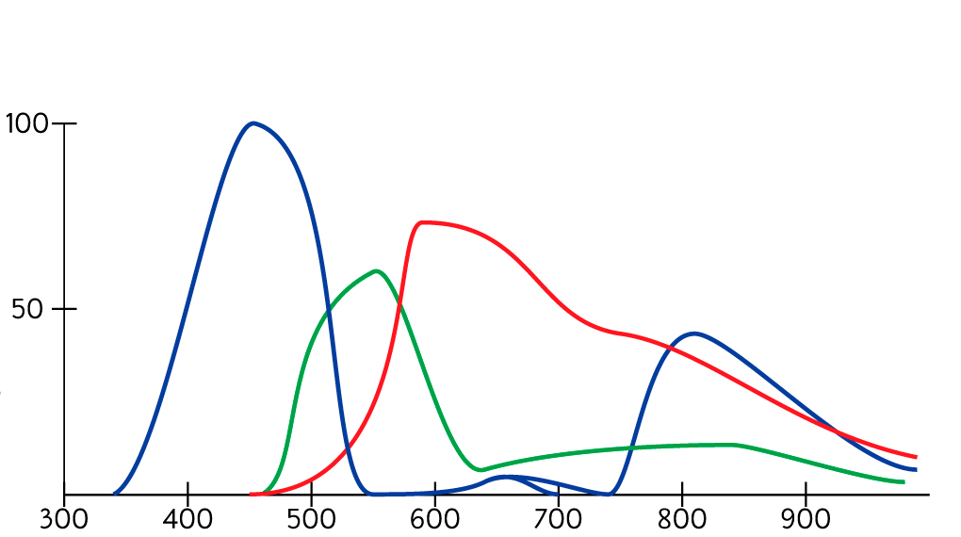
RGB
transmissivity(%)
incoming
transmitted
Absorbance filters
→ Unwanted light is absorbed
Notes:
Flare in RGB cameras is formed mainly by the Lens elements.
But what I am going to show is that in instant hyperspectral cameras there is additional flare from the filters.
If we look at wideband RGB cameras, the color filters are absorbance filters, meaning that unwanted light is absorbed.
For example, if we have purple light going through a blue filter, blue light will be transmitted and the rest will be absorbed.
----
Flare in RGB cameras is formed mainly by the Lens elements. The purpose of filters is to separate unwanted light (Other colors) but filters not only absorb but also reflect unwanted light. In normal RGB cameras unwanted light is largely absorbed or transmitted by the broadband glass-colored filters and so it is only a 'weak signal contaminator'

Slide 14
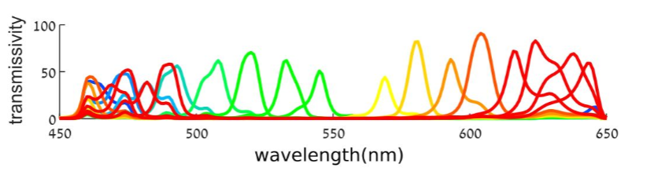
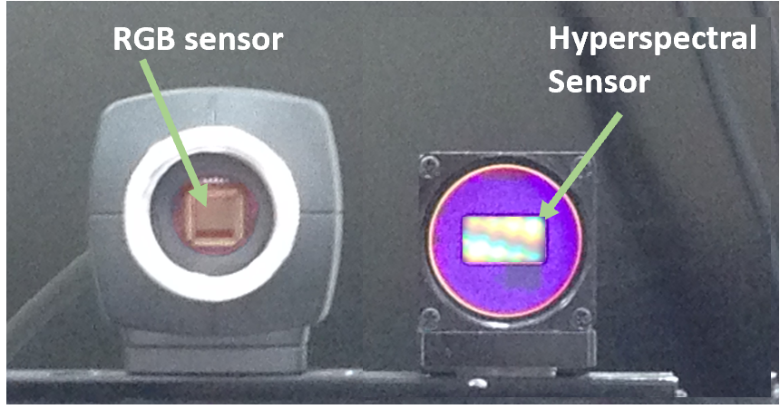
RGB
Hyperspectral
transmissivity(%)
incoming
transmitted
incoming
transmitted
reflected
Absorbance filters
→ Unwanted light is absorbed
Inteference (Fabry Perot) filters
→ Unwanted light is reflected
Notes:
but the filters used for instant Hyperspectral are interference Fabry-Perot filters, to enable narrowband transmission.
These FP filters reflect unwanted light! and absorb almost no light at all. This means that as narrowband filters they act as near efficient/very good mirrors that reflect unwanted light – over 95% of the wavelength spectrum.
In the same case of the purple light incident on a blue filter, the blue is transmitted and the remaining red is reflected.
To demonstrate it I took a picture of the sensors.
We can see the hyperspectral sensor acts like a mirror.

Slide 15
How Much Light is Reflected Back?
Transmissivity(%)
Reflectivity(%)
Wavelength(nm)
Wavelength(nm)
Reflectivity = 100%- Transmissivity
Notes:
So how much light is reflected from the sensor?
Let us look for example at the transmission of two filters.
The transmission is narrow-band, as we require.
The unwanted light is almost entirely reflected and so we show you R = 100%-T.
You can see that most of the incident light is actually reflected.
That is why we suspected there will be significant flare as a result of these filters

Slide 16
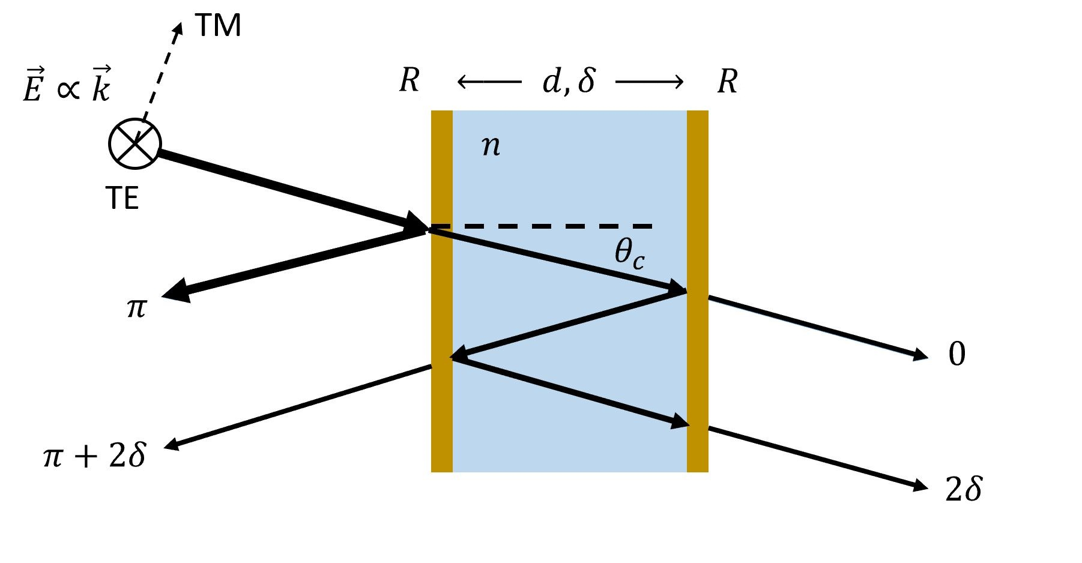

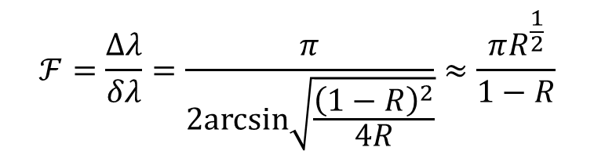
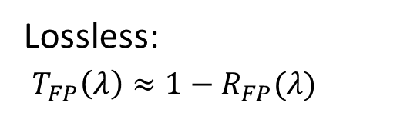
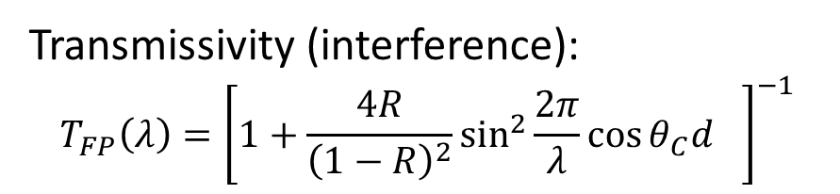
Fabry-Perot (Interference) filters
Transmissivity (interference):
$$T_{FP}\left(λ\right)={\left[1+\frac{4R}{{\left(1−R\right)}^{2}}\sin^{2}{\frac{2π}{λ}{\cos{θ_{C}d}}_{}}\right]}^{−1}$$
Lossless:
$T_{FP}\left(λ\right)≈1−R_{FP}(λ)$
Finesse
$$ℱ=\frac{Δλ}{δλ}=\frac{π}{2arcsin\sqrt{\frac{{\left(1−R\right)}^{2}}{4R}}}≈\frac{πR^{\frac{1}{2}}}{1−R}$$
For reflectivity 0$≤R≤1$
Notes:
Transmissivity of a theoretical etalon can be calculated in closed form. It is well known expression from the literature that can be calculated as an infinite sum of reflections (Fresnel)
If little or no light is absorbed in the layer than non-transmitted light is equal to the reflected light.
Finesse is a standard unit to determine the available measurement contrast and precision by the etalon (SHYC obviously require high finesse or high mirror reflectivity).

Slide 17





Fabry-Perot Interference filters
R
R
Obj. Lens
$$n$$
pixel
$$n$$
$$d$$
$$←d→$$
$$n$$
FP filter
Notes:
And high mirror reflectivity means that considerable radiance is directed toward the objective lens
Let us make a small pause here and discuss previous work done on flare

Slide 18
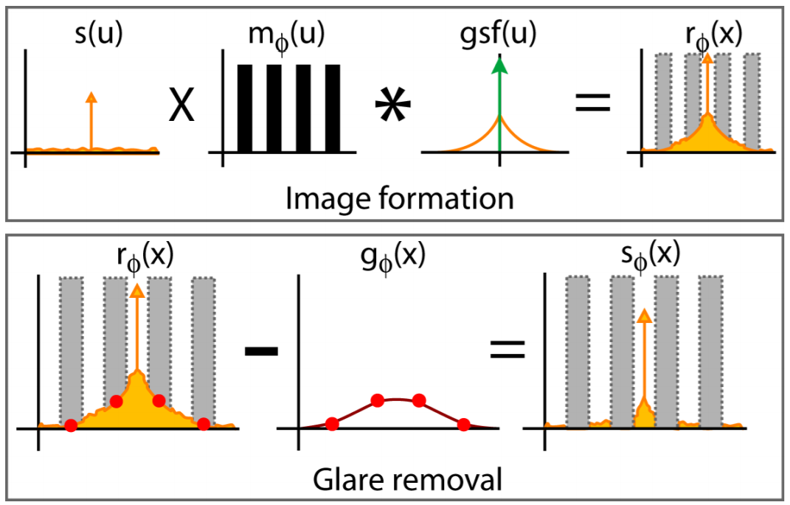
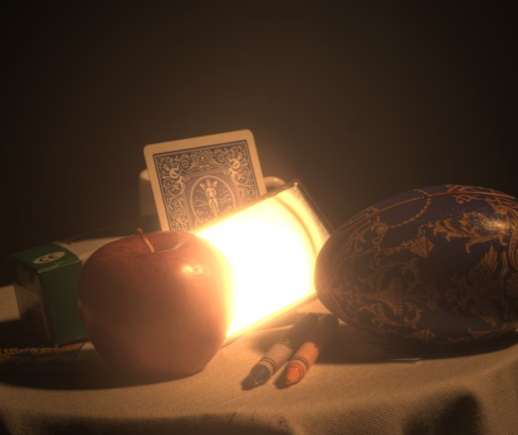
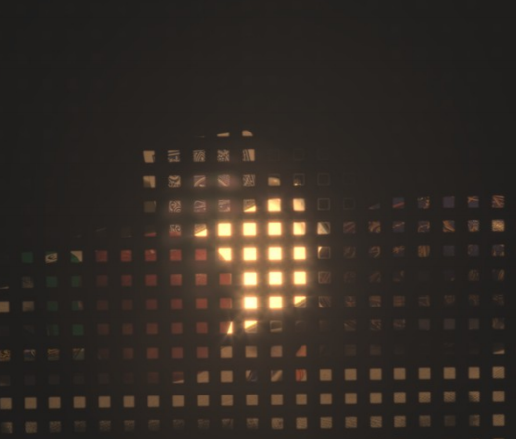
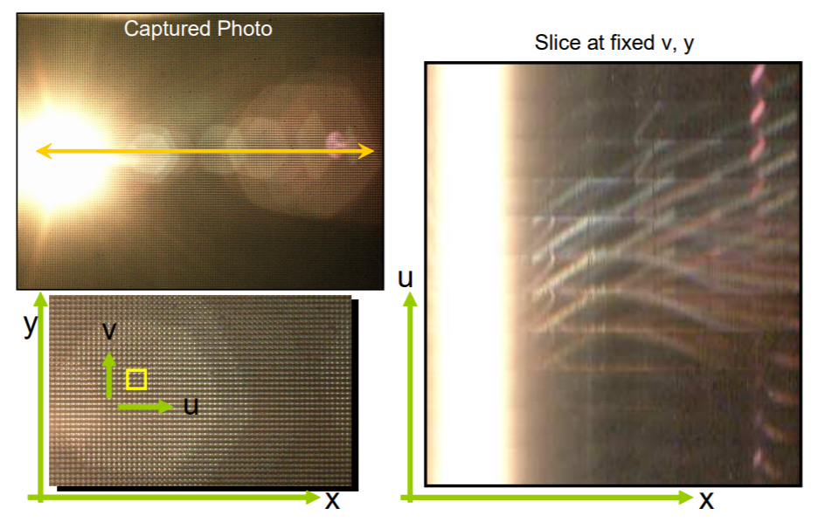
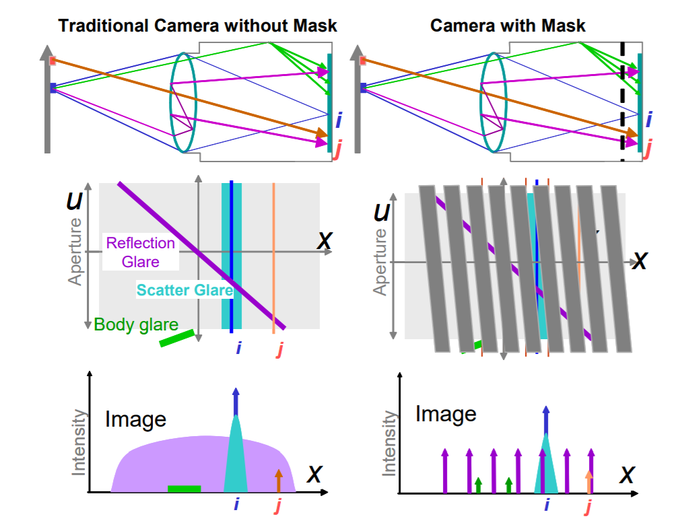
Prior works
Talvala et al. 2007
Raskar et al. 2008
Notes:
There are several works that looked at flare in RGB cameras and tried to remove it by different methods.
For example these methods used additional masks which should work in our case but have yet to investigated this.
---- YOU DON’T NEED TO EXPLAIN THE PART BELOW
– The first ‘Levoy et al.’ places the mask in front of the camera and Raskar et al. place it at the between the sensor and the conjugate plane which is an early model of Light-Field Cameras which are sensitive to angles and with this information they show separability of those signals in the joint angle-space coordinates (or 4D Light-Field if somebody asks)

Slide 19
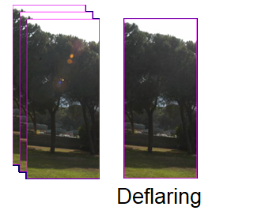
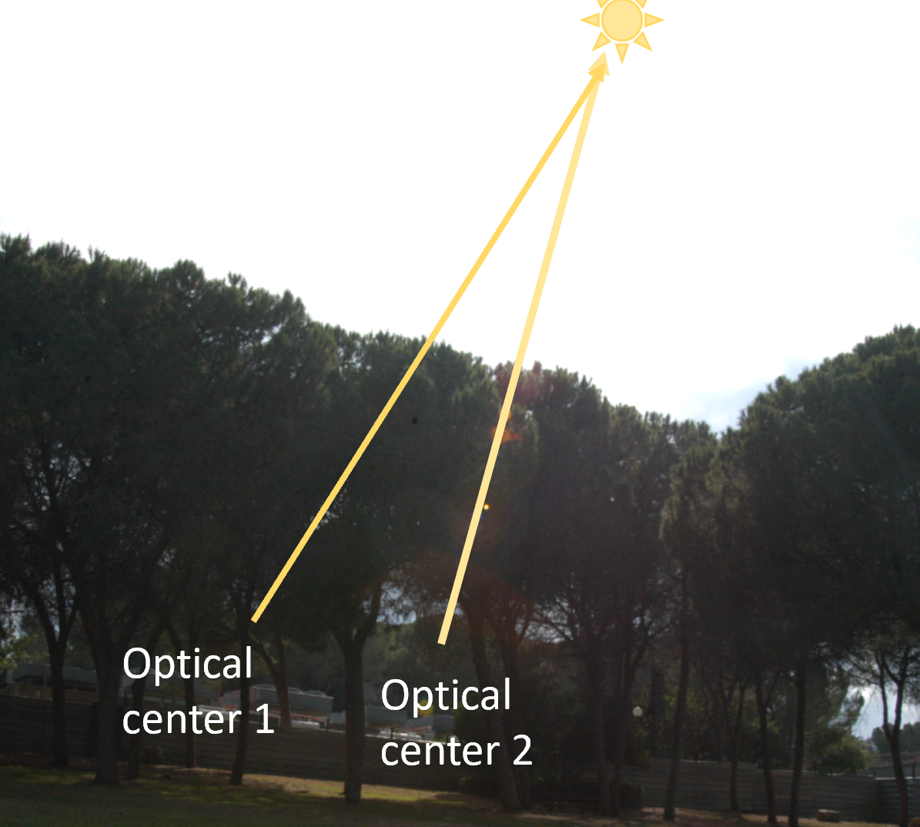
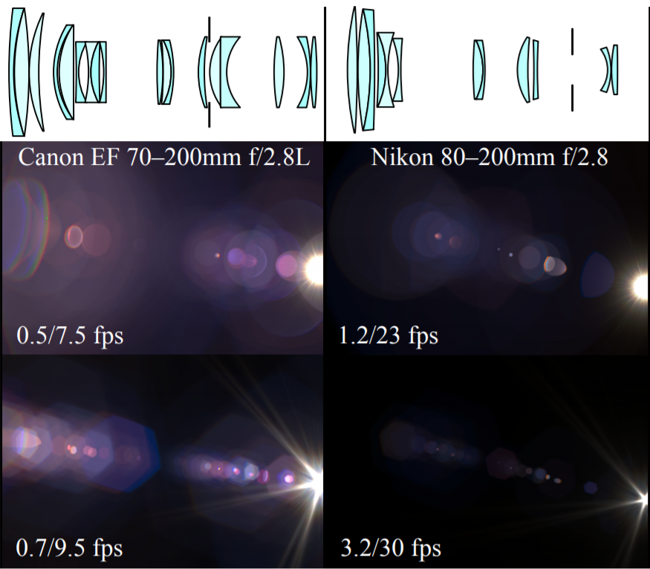
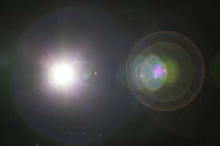
Prior works
Koreban & Schechner 2009
Hullin et al 2011
Notes:
The first work, done in our lab takes advantage of the fact that sun-flares are bright and sensitive to slight camera motion. This is a great geometrical property → We learn from this work that flare is concentrated on straight lines going through the optical center (which makes good sense since the lens has radial symmetry). This gives both deflaring and positioning of the sun outside the FOV.
Hullin et al. render Flare from physical lens models and efficiently

Slide 20
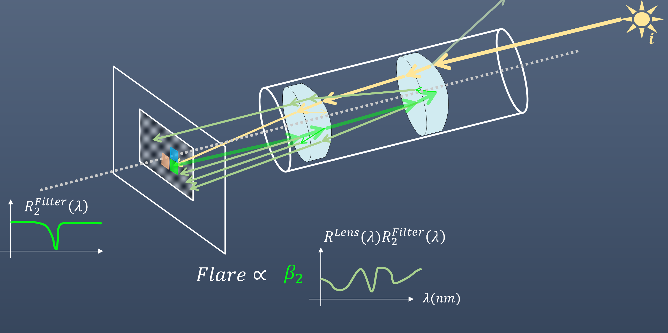
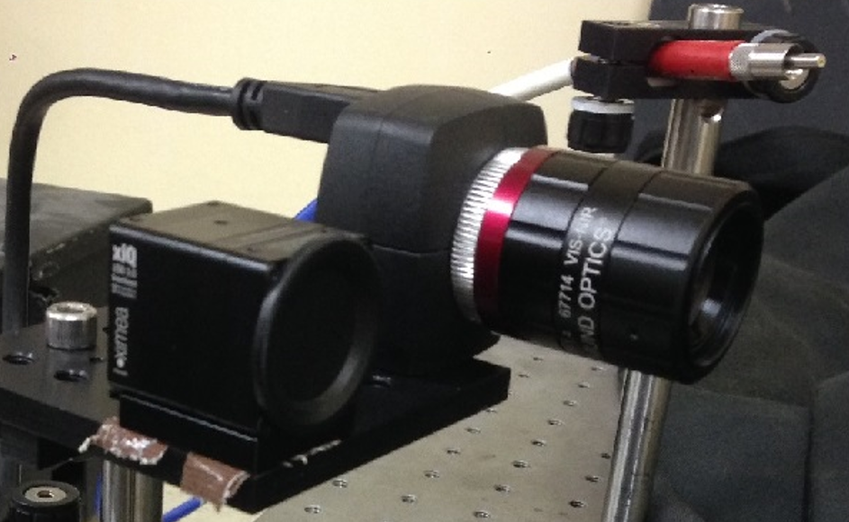
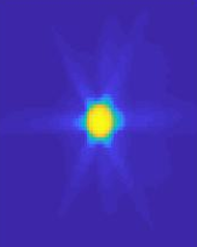
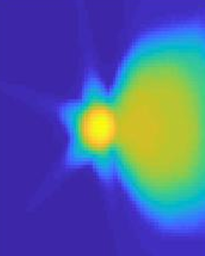
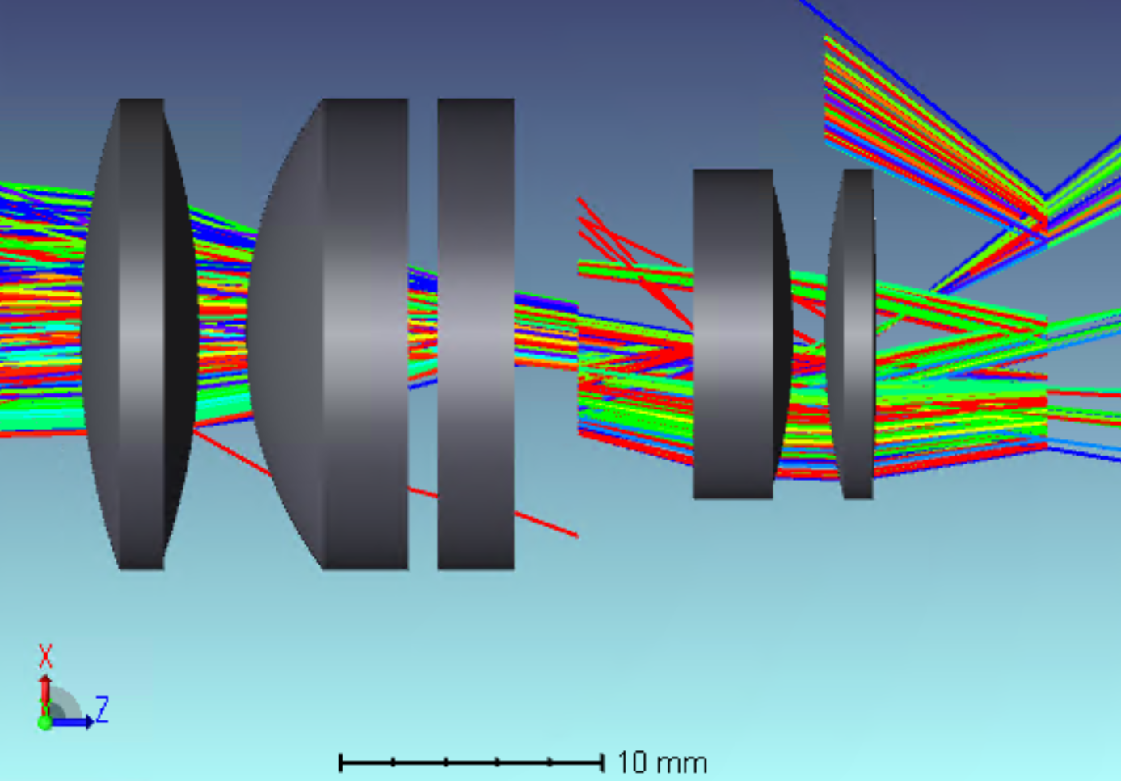
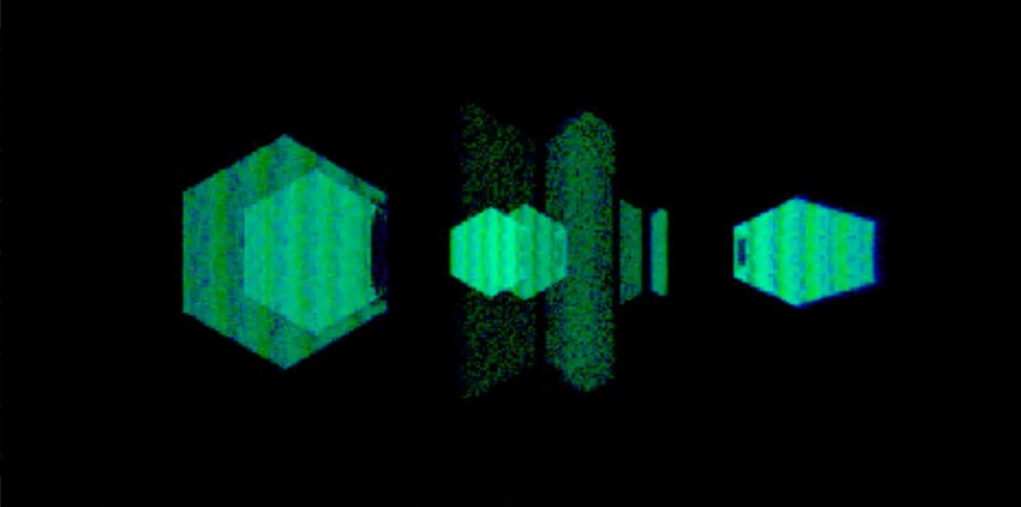
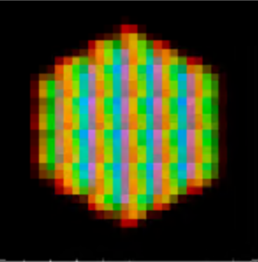
Our work
Image formation analysis
Flare in the order of 2-5% of the signal
RGB
HSI
Experiments
Simulations
Notes:
As you see, there has been considerable interest in flare.
However, no prior works analyzed the flare in instant hyperspectral cameras.
We performed analysis, experiments, and simulations
That showed that the flare is in the order of 3-5% of the signal, which is very significant

Slide 21

Lens reflection
$$S$$
pixels
Lens
Optical
axis
Lens
Filter array
Primary Lens Reflection 1st order ( >> Secondary reflections)
In the order of surface reflectivity times the number of lenses
Notes:
Let us look at it with more details. As light enters the optical system, some light is reflected by lenses. This light has wavelength-spectrum proportional to the lens Reflectance profile. As light reaches the sensor plane a portion is bounced by the Filters and with irradiance that is proportional to their reflectance. So a single lens reflection and a single Filter reflection form Flare in the image plane that is recorded by the sensor.

Slide 22















Photometry
$$R_{Lens}\left(λ\right)$$
$$I_{source}^{x}(λ)$$
A green filter at spatial coordinates $x$,
Red filter at $y$
$$i$$
$$λ(nm)$$
$$T_{FP}^{y}\left(λ\right)$$
$$y$$
$$x$$
$$R_{Lens}\left(λ\right)×R_{FP}^{x}\left(λ\right)$$
$$×$$
$$I_{source}\left(λ\right)×T_{FP}^{y}\left(λ\right)$$
$$R_{FP}^{x}\left(λ\right)$$
$$O\left[F\left(y,λ | x\right)\right]=$$
$$λ(nm)$$
$M$-Lenses cause $2M$ 1st order reflections ➔ Flare is additive by the number of lenses
Reflection recorded at $y$ due to $x$ $O[F\left(y,λ | x\right)]=2MI_{source}^{x}\left(λ\right)R_{lens}\left(λ\right)R_{FP}^{x}\left(λ\right)T_{FP}^{y}\left(λ\right)$
Notes:
Let us take another look at it again with mathematical expressions:
More specifically let us consider a single ray of light the was reflected by a filter positioned at spatial position x on the sensor. The spectrum of the non transmitted light is shaped by the reflectivity of that green filter. The ray proceeds toward the objective lend where the reflected by the objective lens, that is the spectrum of the non-transmitted light is shaped the reflectivity of the lens(AR coating reflectance profile)\ other non-lens elements. This light proceeds toward the sensor again where a portion is transmitted by the red filter with transmissivity T

Slide 23



Photometry
We define contamination $C$ in region $Ω$(by FIIF) as the ratio between direct energy and FIIF energy:
$$C=\frac{E_{FP}}{E_{source}}$$
Where:
$$E_{FP}=\sum_{y∈Ω}{\int_{λ}{F_{FP}\left(y,λ\right)}}$$
$$E_{source}=\sum_{y∈Ω}{\int_{λ}{I_{source}\left(y,λ\right)}}$$
Notes:
We define total contamination in region OMEGA as the ratio between total radiant flux and direct radiant flux as recorded by the sensor

Slide 24
Photometry summary
Regular cameras we observe a Secondary reflections
But in FIIF forms by a 1st order (primary) lens reflection
2nd order Lens reflection
1st order Lens reflections
Interference
filters
filter array
Notes:
Just a quick summary Second order reflections are weaker.
First order are strong in SHYC

Slide 25

Experimental setup

Slide 26




















Experiment Results
Sensor axis $x$
Sensor axis $x$
Regular(mono) sensor
Hyperspectral Sensor (Avg bands)
EO 16mm f# 2.8
EO 16mm f# 2.8
Log10
Log10
Sensor axis $x$
$0$
$1$
Sensor axis $x$
$0.5$
$1$
$0.5$
$0$
Notes:
The image on the left was taken by regular (mono) camera and on the right we see the images taken by instant Hyperspectral and it is clear that there is strong Flare only in the Hyperspectral data. Both sequences of images were taken with identical camera lens and setting (f#2.8)

Slide 27


Data➔
Contamination➔
Notes:
We repeated over different camera settings and orientation.
SAY SOMETHING INTERESTING ABOUT IT- WHAT DO WE SEE?
We see this typical sensitivity of flares to the orientation of the camera. We see three reflection are concentrated around the direct spot but shift more rapidly. Flare decreases in size with increasing f#. It also taken after the hexagonal shape of the shutter as flare often does.

Slide 28


Contamination
Data➔
z
flare shutter
Contamination(%)
o
direct
z
flare lens
Manually selecting signal region
o
filter-shutter flare
filter-lens flare
noise
Notes:
We hand-picked the pixels in each image manually. The dashed ellipses marked in the image are flares – we summed irradiance for those pixels and that of the spot (with diffraction star) is the direct light and divided flare/direct and we present here ratio in %. This was done for f#1.4 and f#16. The weak flares on the right are from the lenses and the stronger one (red) is possibly reflections from other optical elements (shutter) we are not sure yet. We show the ratio of direct light contamination (total) amounts to an order of several percent with respect to direct signal.
YOU NEED TO EXPLAIN WHAT ARE WE SEEING AND HOW YOU CALCULATED IT –
We summarized the contamination levels (SUMMARIZED WHAT?) for a few camera orientations and f# that we’ve experimented with and show you that this Flare is indeed very strong. The green (GREEN OR RED?) line originates from lens reflections while the blue line has a different spectrum. Because of that we hypothesize it comes from the metalic shutter. Please observe that the blue line which we expect formed at the lenses gradually decreases with f# while the red line increases. We also see that noise in black which increases slightly with f#.
WHAT DID YOU CALCULATE? HOW?

Slide 29


Software Tools
High performance Raytracing software including Lens design tools.
Rich catalogue elements (Lenses, Materials, Coating-profiles, Scatter-profiles, Sources).
Notes:
After seeing in the experiments that there is significant flare we wanted to quantify it in a more controlled way, through simulations.
To simulate we used ZEMAX, a standard tool for lens design and raytracing.
It also has APIs (Matlab,Python,C)

Slide 30


Simulated Lens (AR Coating)
Entrance pupil
Iris blades
Exit pupil
AR profile - matched to experimental
We simulated two coating profiles for the same lens (and experimented with other lenses as well, including single-lens imaging setup)
Notes:
As you probably know, lens manufacturers tend not to publish the lens models.
We use the simulated Edmund optics lens catalogue which is the closest one that we could find to the lens that we used in the experiments.
We also inserted a shutter that we can simulate as both reflective/absorbing and simulate f# effect in the simulative model.

Slide 31




FIIF Simulations
Edmund Optics #59-870
Direct
Stray
Notes:
We simulated the components of the system: lens, and FP filters.
NOT SURE WHAT ELSE YOU WANT TO SAY HERE→ A 3D shaded view of the lens+sensor that we used for the simulations.
At the top we see a 3D shaded view- only direct light
The bottom one- including the flare

Slide 32




Simulated Sensor
Transmittance(%)
$$256×512×16=1024×2048$$
Notes:
Here are some Filter transmittance that we shaped in Zemax (with high order FP resonance and broad-passband coating).
Transmissivity is obviously a function of angle of incidence

Slide 33









f#1.4
f#4.0
f#16.0
z
o
z
o
z
o
Notes:
We repeated over different camera settings and orientation.
SAY SOMETHING INTERESTING ABOUT IT- WHAT DO WE SEE?
We see this typical sensitivity of flares to the orientation of the camera. We see three reflection are concentrated around the direct spot but shift more rapidly. Flare decreases in size with increasing f#. It also taken after the hexagonal shape of the shutter as flare often does.

Slide 34

Contamination
z
o
Contamination(%)
z
o
z
o
Wavelength(nm)
Notes:
And the simulations show about 2.5% Flare by the Filters+Lenses. This only explains the blue curve (contamination) in the experimental data but does not explain the red curve.
We are planning to simulate the shutter to see if it explains the red curve.

Slide 35


Slide 36

Partially Reflective Iris Blades
f#1.4
f#4.0
f#16.0
z
o
z
o

Slide 37
Partially Reflective Iris Blades
AR(lens) reflectance (EO VIS-NIR 673)
Metal(diffuse) reflectivity
F-number
reflectivity(%)
reflectivity(%)
z
o
Contamination(%)
z
o
Notes:
Here we account for partially reflective shutter blades.

Slide 38


Contamination(%)

Slide 39

Raytracing vs Theoretical prediction
Filter average Reflectance
Reflectance(%)
Theory
Contamination(%)
Simulation
Wavelength(nm)
Lens coating
Reflectance(%)
$$O\left[F_{FP}^{single}\left(λ\right)\right]\sim 2MR_{lens}\left(λ\right)\sum_{x}{I_{source}^{x}\left(λ\right)R_{FP}^{x}\left(λ\right)}=$$
Wavelength(nm)
Notes:
Top figure is Filter average reflectance. Bellow that is the Lens coating profile and on the right are both this multiplication and the smooth line is by raytracing and binning the rays by wavelength.
Average Filter (mosaic) reflectance in the simulations.

Slide 40



Deflaring Wide Angle
Rotate + Rectify
➔${ min\left\{I^{fr k}\right\}}_{k}$
Notes:
We show deflaring by two method previously reported.
In Wide-Angle deflaring we scan the scene by rotating the camera quickly and recording several images in video mode.
After this we apply geometric transformation to rectify and select minimal intensity i.e the sample that is least contaminated in the available samples. This method has only partial effect as FIIF are still non-uniforms but some regions are consistently contaminates in all samples

Slide 41



Deflaring – Barrier
Stray Radiance
Notes:
The Barrier method, on the other hand, is more effective as the barrier produces actual flare measurements in the occluded regions. In this method a high resolution mask is shifted quickly across the FOV. We accumulated flare samples (pixelwise maximum) and subtracted from a single non-occluded (FIIF contaminated image).
One the right we tried barrier deflaring (FIIF is formed by light cell phone flash light – which is a white LED) this is highly non uniform FIIF visually one can infer that efficincy depends on the resolution of the barrier (and of course the available number of samples\frames).

Slide 42



Notes:
Average contamination is low but non FIIF can contaminate\cause biases in dark regions that may be considerable. Here we show raw uncorrected measurements. FIIF is only about 2-5% from the direct radiance however contrast in darker regions can be more severely effected (For example if we reconstruct an HDR image we might find strong FIIF)

Slide 43


Conclusions
Significant flare(FIIF) in SHYC (non typical 1st order)
We show evidence and quantify in simulation and experiment
We gave photometric analysis
We apply two effective methods (for lens-flare removal) to FIIF
Experiment
Simulations
Iris blades
Iris blades
C(%)
Lens
Lens
f#1.4
f#4.0
f#16.0
Notes:
To sum up, this technology can open many applications.
But, we showed that it introduces significant flare in the order of several percent.
This interrupts data acquisition from the scene and creates biases in the Hyperspectral data. This mean that accuracy of the data acquired with this type of technology is inherently limited.
We’ve characterized it in terms of photometry and shown through experiment and simulations its formation by a point source for different cameras setting and orientation and show consistency with our analysis.
Some of the previous methods for removing lens flare might work in this case as well. We still need to investigate that.

Slide 44



Acknowledgements
My sincerest gratitude to Tali and Yoav, family ,friends, and fellow students
This research was done in both:
VISL - Vision and Image Sciences laboratory
, Department of Electrical engineering, Technion
Link: http://visl.technion.ac.il/
The Hatter Department of Marine Technologies
Link: http://marsci.haifa.ac.il/
The generous financial help of the Technion and Haifa University is gratefully acknowledged.
Notes:
Thanks to Tali and Yoav for their professional guidance and personal support during this research. Thank you to my family fellow students, collogues and friends for support and fruitful discussions.
This research was done in both VISL Lab in the Viterby Faculty of EE at the Technion and the Hatter Department of Marine technologies in the Charney school of marine sciences – Haifa Uni.

Slide 45
References
Raskar, Ramesh, et al. Glare aware photography: “4D ray sampling for reducing glare effects of camera lenses." ACM Transactions on Graphics (TOG) 27.3 (2008): 56.
Koreban, Fima, and Yoav Y. Schechner. "Geometry by deflaring." Computational Photography (ICCP), 2009 IEEE International Conference on. IEEE, 2009.
Hullin, Matthias, et al. "Physically-based real-time lens flare rendering." ACM Transactions on Graphics (TOG) 30.4 (2011): 108.
Agrawal, Prashant, et al. "Characterization of VNIR hyperspectral sensors with monolithically integrated optical filters." Electronic Imaging 2016.12 (2016): 1-7.

Slide 46
Conclusions
Significant flare(FIIF) in SHYC (non typical 1st order)
We show evidence and quantify in simulation and experiment
We gave photometric analysis
We apply two effective methods (for lens-flare removal) to FIIF
Experiment
Simulations
Iris blades
Iris blades
C(%)
Lens
Lens
f#1.4
f#4.0
f#16.0
Notes:
To sum up, this technology can open many applications.
But, we showed that it introduces significant flare in the order of several percent.
This interrupts data acquisition from the scene and creates biases in the Hyperspectral data. This mean that accuracy of the data acquired with this type of technology is inherently limited.
We’ve characterized it in terms of photometry and shown through experiment and simulations its formation by a point source for different cameras setting and orientation and show consistency with our analysis.
Some of the previous methods for removing lens flare might work in this case as well. We still need to investigate that.

Slide 47
References
Geelen, Bert, Nicolaas Tack, and Andy Lambrechts. "A compact snapshot multispectral imager with a monolithically integrated per-pixel filter mosaic." Advanced Fabrication Technologies for Micro/Nano Optics and Photonics VII. Vol. 8974. International Society for Optics and Photonics, 2014.
Lapray, Pierre-Jean, et al. "Multispectral filter arrays: Recent advances and practical implementation." Sensors 14.11 (2014): 21626-21659.
Miao, Lidan, and Hairong Qi. "The design and evaluation of a generic method for generating mosaicked multispectral filter arrays." IEEE Transactions on Image Processing 15.9 (2006): 2780-2791.
Jenkins, Rhiannon Katarina. ”THE EFFECT OF ADDING ASPHERIC SURFACES TO A FIXED FOCAL LENGTH LENS SYSTEM”. Diss. UNIVERSITY OF ARIZONA, 2016.

Slide 48
References
Brouwer, Oscar R., et al. "Image navigation as a means to expand the boundaries of fluorescence-guided surgery." Physics in Medicine & Biology 57.10 (2012): 3123.
Notes:
Missing references – needs to be added

